Slide 1
Heap Memory Management

Slide 2
Heap Memory Management
Heap is used for allocating space for objects created at run time
For example: nodes of dynamic data structures such as linked lists and trees
Almost all programming languages support dynamic memory allocation and deallocation
malloc() and free() in C programs
new() and delete() in C++ programs
new() and garbage collection in Java programs
Allocation and deallocation may be completely manual (C/C++), semi-automatic (Java), or fully automatic (Lisp)

Slide 3
Memory Manager
Memory Manager is the subsystem that allocates and deallocates space in the heap.
Keep track of all the free space in the heap storage at all the time
Allocation
When a program requests memory for a variable or object, the memory manager produces a chunk of contiguous heap memory of the requested size.
If possible, it satisfies an allocation request using free space in the heap;
if no chunk of the needed size is available, it seeks to increase the heap storage space by getting consecutive bytes of virtual memory from the operating system.
If space is exhausted, the memory manager passes that information back to the application program.

Slide 4
Memory Manager
Deallocation
The memory manager returns deallocated space to the pool of free space, so it can reuse the space to satisfy other allocation requests.
Memory managers typically do not return memory to the operating system, even if the program's heap usage drops.

Slide 5
Memory Manager
The memory manager must be prepared to service, in any order, allocation and deallocation requests of any size, ranging from one byte to as large as the program's entire address space.
Goals
Space efficiency: minimize fragmentation
Program efficiency: take advantage of locality of objects (both temporal and spatial) in memory and make the program run faster
Low overhead: allocation and deallocation must be efficient

Slide 6
Heap Fragmentation
In the beginning, the heap is one large and contiguous block of memory
As allocation requests are satisfied, chunks are cut off from this block and given to the program
As deallocations are made, chunks are returned to the heap and are free to be allocated again (holes)
After a number of allocations and deallocations, memory is fragmented and not contiguous

Slide 7

Heap Fragmentation
To begin with the whole heap is a single chunk of size 500K byte
After a few allocations and deallocations, there are holes
In the above picture, it is not possible to allocate 100K or 150K even though total free memory is 150K

Slide 8
Heap Allocation Strategies
The first-fit strategy picks the first available chunk that satisfies the allocation request
The best-fit strategy searches and picks the smallest (best) possible chunk that satisfies the allocation request
Both of them chop off a block of the required size from the chosen chunk, and return it to the program
The rest of the chosen chunk remains in the heap
Best-fit strategy has been shown to reduce fragmentation in practice, better than first-fit strategy

Slide 9
Bin-based Heap
To implement best-fit placement more efficiently, free space chunks are organized into bins according to their sizes (Lea Memory Manager in GCC)
Many more bins for smaller sizes, because there are many more small objects
A bin for every multiple of 8-byte chunks from 16 bytes to 512 bytes
Then approximately logarithmically (double previous size)
Within each “small size bin”, chunks are all of the same size
In others, they are ordered by size
The last chunk in the last bin is the wilderness chunk, which gets us a chunk by going to the operating system

Slide 10
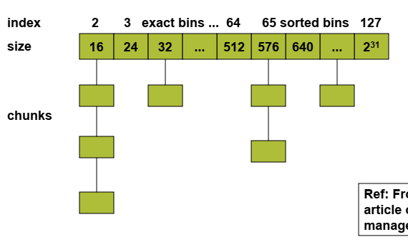
Bin-based Heap
Ref: http://gee.cs.oswego.edu/dl/html/malloc.html

Slide 11
Heap Allocation Strategies
While best-fit placement tends to improve space utilization, it may not be the best in terms of spatial locality.
Chunks allocated at about the same time by a program tend to have similar reference patterns and to have similar lifetimes.
Placing them close together thus improves the program's spatial locality.
Next-fit strategy tries to allocate the object in the chunk that has last been split
Tends to improve speed of allocation
Tends to improve spatial locality since objects allocated at about the same time tend to have similar reference patterns and life times (cache behavior may be better)

Slide 12
Managing and Coalescing Free Space
When an object is deallocated, it is possible to combine (coalesce) the freed chunk with adjacent chunks to form a larger chunk
Coalescing reduces fragmentation
Data structures to support coalescing
Boundary tags (free/used bit and chunk size) at each end of a chunk (for both used and free chunks)
A doubly linked embedded list of free chunks

Slide 13
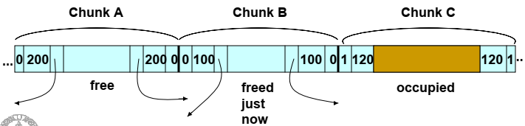
Boundary Tags and Doubly Linked List
3 adjacent chunks. Chunk B has just been deallocated and returned to the free list. Chunks A and B can be merged, and this is done just before inserting it into the linked list. The merged chunk AB may have to be placed in a different bin.

Slide 14
Garbage Collection

Slide 15
Runtime Memory Management
Most constructs in a programming language need memory.
Local variables, Objects, Arrays, Strings etc.
Some memory is preallocated and persists throughout the program:
Global variables, executable code, etc.
Some memory is allocated on the runtime stack:
Local variables, parameters, temporaries.
Some memory is allocated in the heap:
Arrays, objects.
Memory management for the first two is trivial.
How do we manage heap-allocated memory?

Slide 16
Manual Memory Management
Have the programmer handle allocation and deallocation of dynamic memory.
Approach used in C, C++.
Easily leads to troublesome bugs:
Memory leaks
Failing to delete data that cannot be referenced
Important in long running or non-stop programs
Dangling pointer dereferencing
Referencing deleted data
Creates a program error that is hard to debug

Slide 17
Automatic Memory Management
Have the runtime environment automatically reclaim memory.
Approach used in Java, Perl, ML, Prolog etc.
Objects that won't be used again are called garbage.
Reclaiming garbage objects automatically is called garbage collection.

Slide 18
Preliminaries
Garbage collection is the reclamation of chunks of storage holding objects that can no longer be accessed by a program.
Assumptions
Objects have a type that can be determined by the garbage collector at run time.
Type information allows to determine
how large the object is, and
which components of the object contain references (pointers) to other objects.
References to objects are always to the address of the beginning of the object, never pointers to places within the object.
All references to an object have the same value and can be identified easily

Slide 19
Preliminaries
A user program, hereafter referred to as the mutator, modifies the collection of objects in the heap.
The mutator creates objects by acquiring space from the memory manager
May introduce and drop references to existing objects.
Objects become garbage when the mutator program cannot "reach" them
The garbage collector finds these unreachable objects and reclaims their space by handing them to the memory manager, which keeps track of the free space.

Slide 20
A Basic Requirement: Type Safety
For a garbage collector to work, it must be able to tell whether any given data element or component of a data element is, or could be used as, a pointer to a chunk of allocated memory space.
A language in which the type of any data component can be determined is said to be type safe.
There are type-safe languages like ML, for which we can determine types at compile time.
There are other type-safe languages, 'like Java, whose types cannot be determined at compile time, but can be determined at run time. The latter are called dynamically typed languages.

Slide 21
A Basic Requirement: Type Safety
If a language is neither statically nor dynamically type safe, then it is said to be unsafe. .
Unsafe languages, such as C and C++, are bad candidates for automatic garbage collection.
In unsafe languages, memory addresses can be manipulated arbitrarily:
arbitrary arithmetic operations can be applied to pointers to create new pointers, and arbitrary integers can be cast as pointers.
A program theoretically could refer to any location in memory at any time.
Consequently, no memory location can be considered to be inaccessible, and no storage can ever be reclaimed safely.

Slide 22
Performance Metrics
Overall Execution Time
Garbage collection can be very slow. It is important that it not significantly increase the total run time of an application.
Performance is determined greatly by how it leverages the memory subsystem.
Space Usage
Need to avoid fragmentation and make the best use of the available memory.

Slide 23
Performance Metrics
Pause Time
Simple garbage collectors are notorious for causing programs - the mutators - to pause suddenly for an extremely long time, as garbage collection kicks in without warning.
In addition to minimizing the overall execution time, it is desirable that the maximum pause time be minimized.
Special case of real-time applications -
Requires certain computations to be completed within a time limit.
Garbage collection must be suppress while performing real-time tasks, or restrict maximum pause time.
In practice, garbage collection is seldom used in real-time applications.

Slide 24
Performance Metrics
Program Locality
The garbage collector controls the placement of data and thus influences the data locality of the mutator program.
It can improve a mutator's temporal locality by freeing up space and reusing it
It can improve the mutator's spatial locality by relocating data used together in the same cache or pages

Slide 25
Reachability
Root set: all the data that can be accessed directly by a program, without having to dereference any pointer
For example, in Java the root set of a program consists of
all the static field members and all the variable on its stack.
A program obviously can reach any member of its root set at any time.
Recursively, any object with a reference that is stored in the field members or array elements of any reachable object is itself reachable.

Slide 26
Reachability
Reachability becomes a bit more complex when the program has been optimized by the compiler.
First, a compiler may keep reference variables in registers. These references must also be considered part of the root set.
Second, even though in a type-safe language programmers do not get to manipulate memory addresses directly, a compiler often does so for the sake of speeding up the code. Thus, registers in compiled code may
point to the middle of an object or an array, or
they may contain a value to which an offset will be applied to compute a legal address.

Slide 27
Reachability
To find the correct root set by the GC, an optimizing compiler can –
restrict the invocation of garbage collection to only certain code points in the program, when no "hidden" references exist.
write out information that the garbage collector can use to recover all the references, such as specifying which registers contain references, or how to compute the base address of an object that is given an internal address.
assure that there is a reference to the base address of all reachable objects whenever the garbage collector may be invoked.

Slide 28
Reachability
The set of reachable objects changes as a program executes.
It grows as new objects get created and shrinks as objects become unreachable.
It is important to remember that once an object becomes unreachable, it cannot become reachable again.

Slide 29
Reachability
There are four basic operations that a mutator performs to change the set of reachable objects.
Object Allocations
Performed by the memory manager, which returns a reference to each newly allocated chunk of memory.
This operation adds members to the set of reachable objects.
Parameter Passing and Return Values
References to objects are passed from the actual input parameter to the corresponding formal parameter, and from the returned result back to the callee.
Objects pointed to by these references remain reachable.

Slide 30
Reachability
Reference Assignments
Assignments of the form u = v, where u and v are references, have two effects.
First, u is now a reference to the object referred to by v . As long as u is reachable, the object it refers to is surely reachable.
Second, the original reference in u is lost. If this reference is the last to some reachable object, then that object becomes unreachable.
Any time an object becomes unreachable, all objects that are reachable only through references contained in that object also become unreachable.
Procedure Returns
As a procedure exits, the frame holding its local variables is popped off the stack.
If the frame holds the only reachable reference to any object, that object becomes unreachable.
Again, if the now unreachable objects hold the only references to other objects, they too become unreachable, and so on.

Slide 31
Finding Unreachable Objects
There are two basic ways to find unreachable objects.
Catch the transitions as reachable objects turn unreachable,
Periodically locate all the reachable objects and then infer that all the other objects are unreachable.
Reference counting, is a well-known approximation to the first approach.
A count of the references to an object is maintained, as the mutator performs actions that may change the reachability set.
When the count goes to zero, the object becomes unreachable.

Slide 32
Finding Unreachable Objects
The second approach computes reachability by tracing all the references transitively.
A trace-based garbage collector
starts by labeling ( "marking" ) all objects in the root set as "reachable,"
examines iteratively all the references in reachable objects to find more reachable objects, and labels them as such.
This approach must trace all the references before it can determine any object to be unreachable.
But once the reachable set is computed, it can find many unreachable objects all at once and locate a good deal of free storage at the same time.
Because all the references must be analyzed at the same time, it is possible to relocate the reachable objects and thereby reduce fragmentation.

Slide 33
Reference Counting Garbage Collectors
A simple framework for garbage collection.
Though it has several serious weaknesses!
Idea: Store in each object a reference count (refcount) tracking how many references exist to the object.

Slide 34
Reference Counting Garbage Collectors
Reference counts can be maintained as follows:
Object Allocation. The reference count of the new object is set to 1.
Parameter Passing. The reference count of each object passed into a procedure is incremented.
Reference Assignments. For statement u = v, where u and v are references, the reference count of the object referred to by v goes up by one, and the count for the old object referred to by u goes down by one.
Procedure Returns. As a procedure exits, all the references held by the local variables of that procedure activation record must also be decremented.
If several local variables hold references to the same object, that object's count must be decremented once for each such reference.
Transitive Loss of Reachability. Whenever the reference count of an object becomes zero, we must also decrement the count of each object pointed to by a reference within the object.

Slide 35
Reference Counting in Action
Root Set (Stack)
Objects (Heap)
class LinkedList {
LinkedList next;
}
int main() {
LinkedList head = new LinkedList;
LinkedList mid = new LinkedList;
LinkedList tail = new LinkedList;
head.next = mid;
mid.next = tail;
mid = tail = null;
head.next.next = null;
head = null;
}
Reclaimed
0
head
1
Reclaimed
1
mid
0
2
Reclaimed
1
tail
2
0

Slide 36
Problem with Reference Counting
Root Set (Stack)
Objects (Heap)
class LinkedList {
LinkedList next;
}
int main() {
LinkedList head = new LinkedList;
LinkedList mid = new LinkedList;
LinkedList tail = new LinkedList;
head.next = mid;
mid.next = tail;
tail.next = head;
head = null;
mid = null;
tail = null;
}
2
head
1
mid
1
2
1
tail
2
Reference Cycle

Slide 37
Reference Cycles
A reference cycle is a set of objects that cyclically refer to one another.
Because all the objects are referenced, all have nonzero refcounts and are never reclaimed.
Issue: Refcount tracks number of references, not number of reachable references.
Major problems in languages/systems that use reference counting e.g. Perl.

Slide 38
Analysis of Reference Counting
Disadvantages:
Cannot collect unreachable, cyclic data structures
The overhead is high. Proportional to the amount of computation in the program, and not just to the number of objects in the system.
Advantages:
Can be performed in an incremental fashion.
Even though the total overhead can be large, the operations are spread throughout the mutator's computation.
The operation of recursively modifying reference counts can be deferred and performed piecemeal across time.
Suitable when timing deadlines must be met, as well as for interactive applications where long, sudden pauses are unacceptable.
Garbage is collected immediately, keeping space usage low.

Slide 39
Trace-Based Collection
Instead of collecting garbage as it is created, trace-based collectors run periodically to find unreachable objects and reclaim their space.
Typically, we run the trace-based collector whenever the free space is exhausted or its amount drops below some threshold.
Trace-based algorithms
Mark-and-Sweep Garbage Collectors: stop-the world algorithms
Basic algorithm
Optimization with Baker’s algorithm
Mark-and-Compact Garbage Collectors
Copying Garbage Collectors

Slide 40
Basic Abstraction
All trace-based algorithms compute the set of reachable objects and then take the complement of this set.
Memory is therefore recycled as follows:
The program or mutator runs and makes allocation requests.
The garbage collector discovers reachability by tracing.
The garbage collector reclaims the storage for unreachable objects.
A memory chunk can be in four states in a GC cycle
Free, Unreached, Unscanned, and Scanned.
The state of a chunk might be stored
in the chunk itself, or
it might be implicit in the data structures used by the garbage-collection algorithm

Slide 41
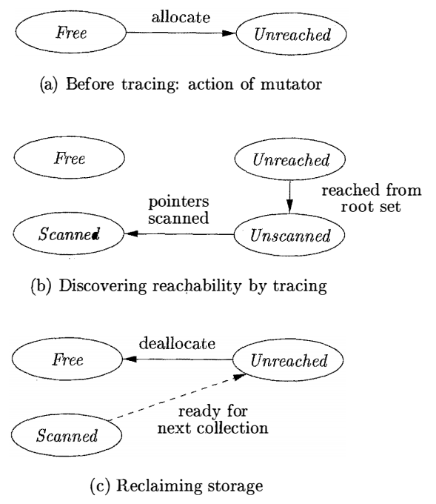
Memory States in a Garbage Collection Cycle
Free
A chunk is in the Free state if it is ready to be allocated.
A Free chunk must not hold a reachable object.

Slide 42
Memory States in a Garbage Collection Cycle
Unreached
Chunks are presumed unreachable, unless proven reachable by tracing.
A chunk is in the Unreached state at any point during garbage collection if its reach ability has not yet been established.
Whenever a chunk is allocated by the memory manager, its state is set to Unreached.
Also, after a round of garbage collection, the state of a reachable object is reset to Unreached to get ready for the next round;

Slide 43
Memory States in a Garbage Collection Cycle
Unscanned
Chunks that are known to be reachable are either in state Unscanned or state Scanned.
A chunk is in the Unscanned state if it is known to be reachable, but its pointers have not yet been scanned.
The transition to Unscanned from Unreached occurs when we discover that a chunk is reachable.

Slide 44
Memory States in a Garbage Collection Cycle
Scanned
Every Unscanned object will eventually be scanned and transition to the Scanned state.
To scan an object, we examine each of the pointers within it and follow those pointers to the objects to which they refer.
If a reference is to an Unreached object, then that object is put in the Unscanned state.
When the scan of an object is completed, that object is placed in the Scanned state.
A Scanned object can only contain references to other Scanned or Unscanned objects, and never to Unreached objects.

Slide 45
Memory States in a GC Cycle
When no objects are left in the Unscanned state, the computation of reachability is complete.
Objects left in the Unreached state at the end are truly unreachable.
The garbage collector reclaims the space they occupy and places the chunks in the Free state
To get ready for the next cycle of garbage collection, objects in the Scanned state are returned to the Unreached state
Though these objects really are reachable right now, the Unreachable state is appropriate because we shall want to start all objects out in this state when garbage collection next begins, by which time any of the currently reachable objects may indeed have been rendered unreachable.

Slide 46
Basic Mark-and-Sweep Collector
Mark-and-sweep runs in two phases
Marking phase:
Visits and “marks” all the reachable objects
Sweeping phase:
“sweeps’’ the entire heap to free up unreachable object

Slide 47
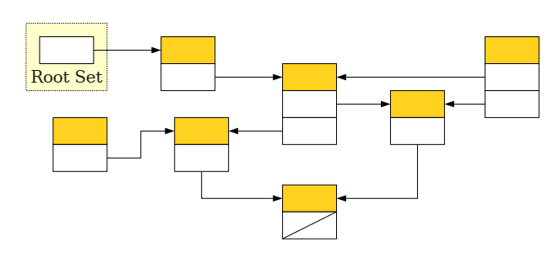
Mark-and-Sweep in Action

Slide 48
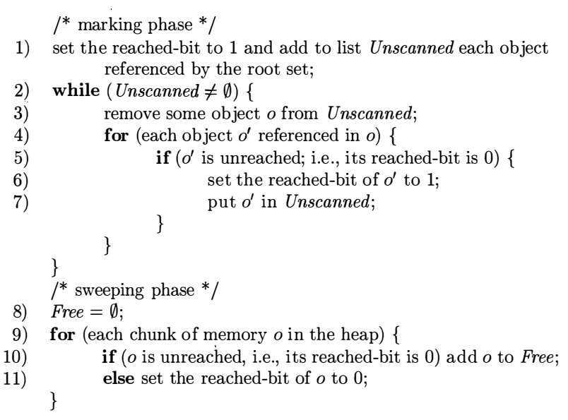
Mark-and-Sweep Garbage Collector
Algorithm: Mark-and-sweep garbage collection
Input:
A root set of objects,
a heap,
a list of unallocated chunks of heap, Free
all chunks are marked with boundary tags
Output:
A modified Free list after all the garbage has been removed
Data Structures:
List Free,
List Unscanned
Reached bits in all objects

Slide 49
Optimizing Mark-and-Sweep Collector
The final step of the basic mark-and-sweep is expensive
Need to examine the entire heap
An improved algorithm due to Baker
Keep a list of allocated objects
Take the set difference of the allocated objects and reached objects to determine the set of unreachable objects

Slide 50
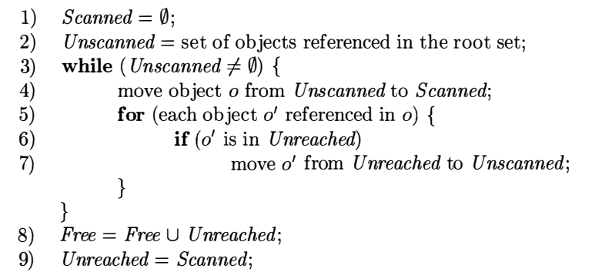
Baker’s Mark-and-Sweep Collector
Algorithm: Baker’s Mark-and-Sweep Collector
Input:
A root set of objects,
a heap,
a free list Free
a list of allocated objects, Unreached
Output:
Modified lists: Free, Unreached holding allocated objects
Data Structures:
Four lists: Free, Unreached, Unscanned, Scanned

Slide 51
Relocating Garbage Collectors
Relocating collectors relocate all the reachable objects into one end of the heap, leaving the entire rest of the heap as one free chunk.
Reduces fragmentation of the memory space
Helps allocation of large objects
Improves a program's temporal and spatial locality
Allows prefetching if objects are used together.
Data structure for maintaining free space is simplified
instead of a free list, all we need is a pointer free to the beginning of the one free block.

Slide 52
Relocating Garbage Collectors
Relocating collectors vary in whether they relocated in place or reserve space ahead of time for relocation
Mark-and-compact collector
Compacts objects in place.
Relocating in place reduces memory usage.
Copying collector
Moves objects from one region of memory to another.
Reserve extra space for relocation.
Allows reachable objects to be moved as they are discovered.

Slide 53
Mark-and-Compact Garbage Collectors
The mark-and-compact collector works in three phases.
Marking phase
similar to that of the mark-and-sweep algorithm
New address calculation phase
Scans the allocated section of the heap and computes a new address for each of the reachable objects.
New addresses are assigned from the low end of the heap, so there are no holes between reachable objects.
The new address for each object is recorded in a structure called NewLocation.
Copying phase
Copies objects to their new locations
Update all references in the objects to point to the corresponding new locations using NewLocation.

Slide 54
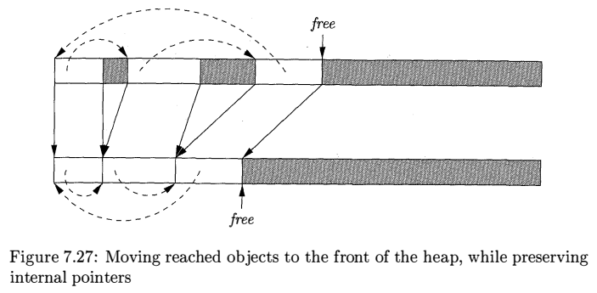
Mark-and-Compact Garbage Collectors

Slide 55
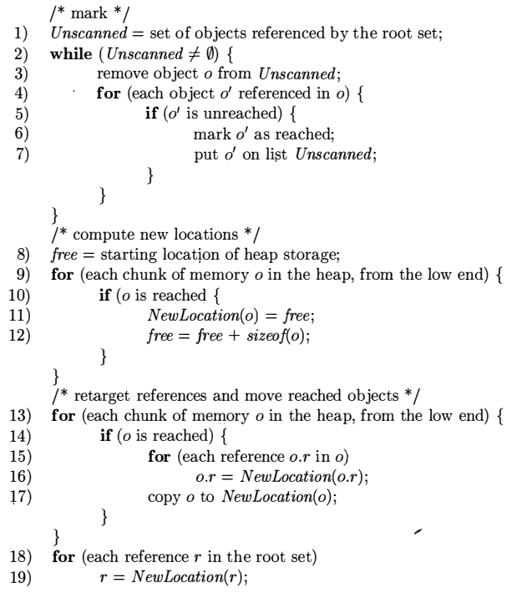
A Mark-and-Compact Garbage Collector
Algorithm: A mark-and-compact garbage collector
Input
A root set of objects,
a heap,
a pointer free marking the start of free space.
Output
The new value of pointer free
Data Structures used
An Unscanned list
Reached bits in all objects
The table NewLocation to keep mappings of objects to their locations
1. Marking
2. New Address Calculation

Slide 56
A Mark-and-Compact Garbage Collector
3. Copying
Algorithm: A mark-and-compact garbage collector
Input
A root set of objects,
a heap,
a pointer free marking the start of free space.
Output
The new value of pointer free
Data Structures used
An Unscanned list
Reached bits in all objects
The table NewLocation to keep mappings of objects to their locations

Slide 57
Copying Garbage Collectors
A copying collector reserves space to which the objects can move
Breaks the dependency between tracing and finding free space
The memory space is partitioned into two semispaces.
The mutator allocates memory in one semispace, until it fills up
At that point the mutator is stopped and the garbage collector copies the reachable objects to the other space.
When garbage collection completes, the roles of the semispaces are reversed

Slide 58
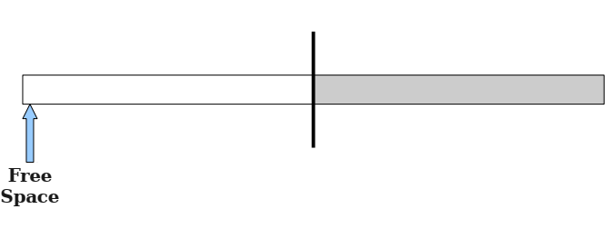
Copying Garbage Collectors in Action
At the very beginning when any object is yet to be allocated
From Semispace
To Semispace

Slide 59
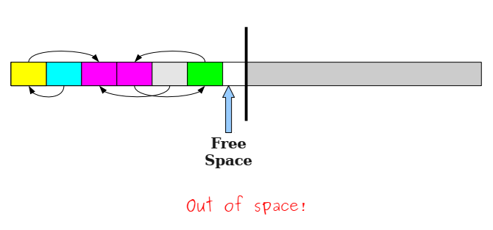
Copying Garbage Collectors in Action
From Semispace is full to a level that no more objects can be allocated.
Need to run Garbage Collector
From Semispace
To Semispace

Slide 60
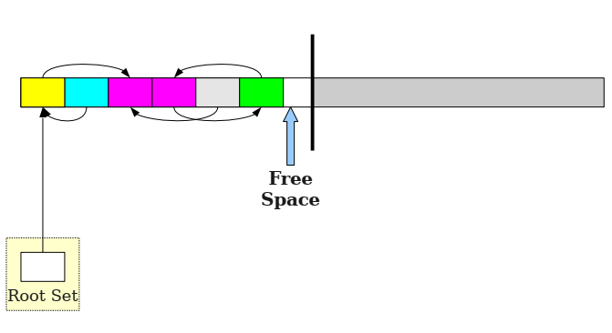
Copying Garbage Collectors in Action
Garbage collected initiated. Start of mark phase
From Semispace
To Semispace

Slide 61
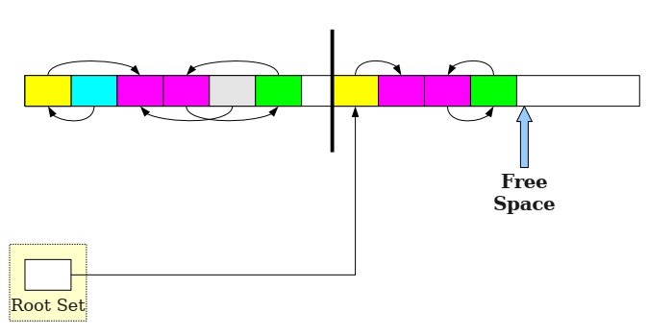
Copying Garbage Collectors in Action
GC running: reachable objects copied from ‘From’ semispace to ‘To’ semispace and all the relevant links are updated
From Semispace
To Semispace

Slide 62
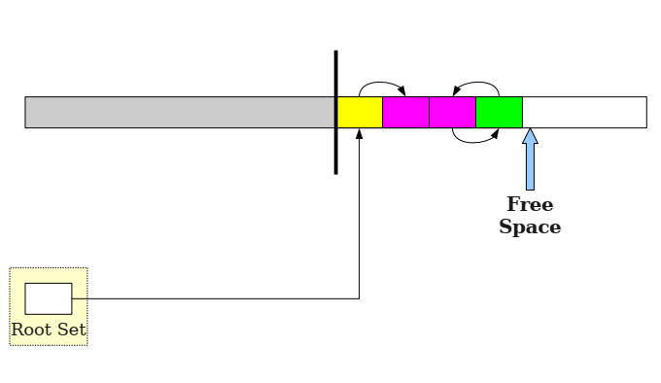
Copying Garbage Collectors in Action
One run of GC complete. Roles of ‘From’ and ‘To’ semispaces are reversed
From Semispace
To Semispace

Slide 63
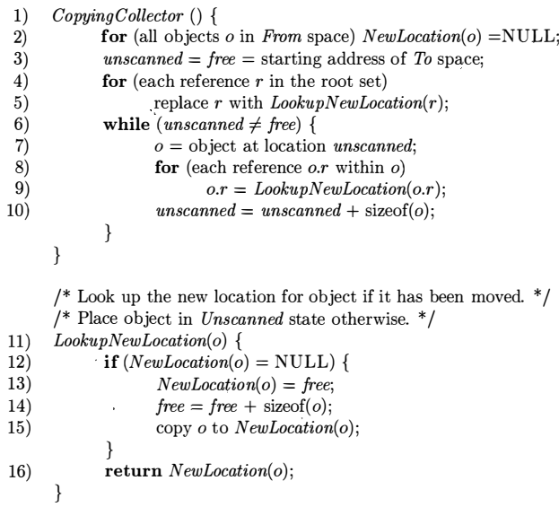
Cheney’s Copying Collector
Algorithm: Cheney’s Copying Collector
Input
A root set of objects,
a heap consisting of two semispaces
From semispace containing allocated objects
To semispace which is free
Output
To semispace holds all the allocated objects
A free pointer pointing to the start of free space in the To semispace
From semispace is completely free

Slide 64
Cheney’s Copying Collector
Advantage
Does not touch any of the unreachable objects.
Disadvantage
Moving the contents of all the reachable objects expensive especially for
large objects and
long-lived objects that survive multiple rounds of garbage collection.

Slide 65
Comparing Costs
Basic Mark-and-Sweep: Proportional to the number of chunks in the heap.
Baker's Mark-and-Sweep: Proportional to the number of reached objects.
Basic Mark-and-Compact: Proportional to the number of chunks in the heap plus the total size of the reached objects
Cheney's Copying Collector: Proportional to the total size of the reached objects

Slide 66
Reference
Compilers: Principles, Techniques, & Tools, by
Alfred B. Aho, Monica S. Lam, Ravi Sethi, Jeffrey D. Ullman
Chapter 7
7.4
7.5
7.6

